Slide 1
WELCOME! Curriculum Night
Fifth Grade
2017-2018

Slide 2
New Initiative: PBIS
Positive Behavior Intervention and Supports
Purpose: To establish common expectations for behavior throughout the school.
Focus: Behavioral expectations (Essential Agreements) linked to IB
R – RESPECT yourself and others
O – Own your COMMITMENTS
A – Act with EMPATHY
R – Radiate INTEGRITY
Uses Class DoJo to reinforce students’ positive behavior
House System to a promote sense of identity and belonging while encouraging school spirit.

Slide 3
International Baccalaureate Program
As an IB school, the curriculum at Jackson focuses on:
*global and cultural awareness
*inquiry and conceptual based teaching
*positive character attributes and attitudes
*central ideas that connect our subject areas
*student-led action

Slide 4
Meet Your Teacher
I have taught for 28 years in Cleveland, Charleston, Tampa, and Charlotte.
This is my 10th year at Jackson Elementary.
During that time, I’ve taught 3rd, 4th, and 5th grades.
I have a masters degree in Literacy and Mathematics. I am currently working on my Gifted Certification.
I was born and raised in Ohio. I have two brothers, a sister, three nieces, three nephews, two dogs, and two cats.

Slide 5
Class Schedule
7:30-8:00 Morning Work
8:05-9:15 Math
9:15-10:00 Science
10:00-10:30 Recess
10:30-11:00 Lunch
11:05-12:15 Language Arts with Mrs. Treibel
12:15-12:50 Social studies with Mrs. Treibel
12:55-1:40 : M: STEAM, T: Writer’s Workshop, W: Writer’s Workshop, Th: French
F: French
1:45-2:30 Specials

Slide 6
Grading Policy
All grades are cumulative
Grades are weighted as follows: Grades are weighted as follows: Tests/Projects 40% Quizzes 30% Classwork 30%
Infinite Campus Parent Portal Access (show ID to the front office)
Any grade below a 70 must be signed and returned
This Photo by Unknown Author is licensed under CC BY-NC-ND

Slide 7
Homework Policy
Homework is on the board every morning
Read for 30 minutes
Study vocabulary words nightly
Study social studies nightly
Written homework that is not completed results in a loss of dojo, and students complete it during recess.

Slide 8
Attendance Policy
Our attendance directly impacts our school CCRPI score (school ranking) so it is very important that your child is present.
If you drive your child to school in the mornings, it would be helpful if he/she arrives between 7:30-7:50 so that he/she has time to unpack and record homework in his/her agenda. Class begins at 8:00 sharp!
Leaving school before 11:30 is considered an absence.
If your child is sick, please email me so I can mark their absence as excused in Infinite Campus.
Whenever possible, please schedule orthodontist and other appointments after 1:45 so that instruction time is maximized.

Slide 9
Class Dojo
Class Dojo is a behavioral management system used school-wide. Students can earn and lose points. Points are lost when students fail to follow our Essential Agreements (R.O.A.R). Students can purchase items with their Dojo dollars from our class store.

Slide 10
Language Arts
Word Work: Greek and Latin roots, Affixes
Mentor Sentences
Writer’s Workshop
Writing: 5 paragraph essays
Narrative, Opinion, and informational
This Photo by Unknown Author is licensed under CC BY-SA

Slide 11
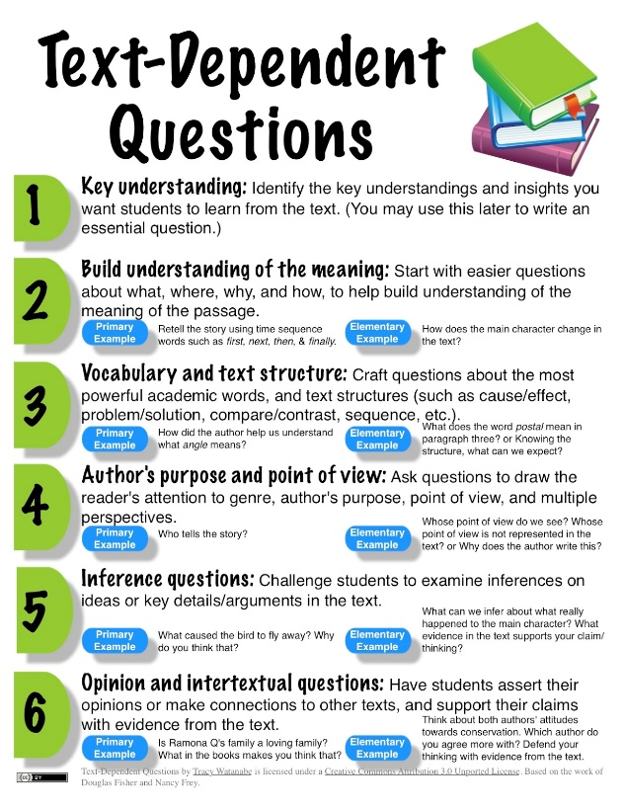
Reading
Reading groups daily. The target will be deeper level comprehension questions, fluency, and weekly skills.
Close reading
Paired Passages
Constructed Responses
This Photo by Unknown Author is licensed under CC BY-NC-SA

Slide 12
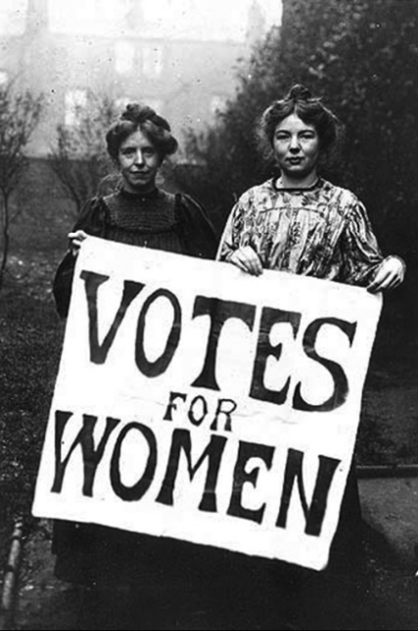
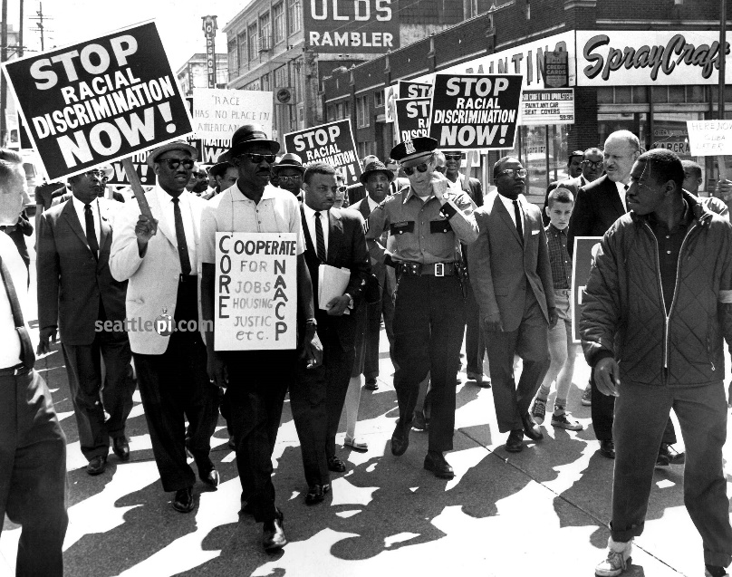
Social Studies
Spanish American War through Modern Times
Content includes WW1, WW2, Civil Rights Movement, Vietnam War, Desert Storm, September 11, Afghanistan
Economics
This Photo y Unknown Author islicensed under CC BY-SA
This Photo by Unknown Author is licensed under CC BY-SA
This Photo by Unknown Author is licensed under CC BY-SA

Slide 13
Math
Topics include:
Place Value through Hundred Billions
Add, Subtract, Multiply, and Divide Fractions and Decimals
Measurement Customary and Metrics
Geometry: Area, Perimeter, Volume
The math curriculum is Eureka with supplemental materials as needed.

Slide 14
Science
Topics include:
Scientific Method
Electricity and Magnetism
Cells and Microorganisms
Genetics
Landforms

Slide 15
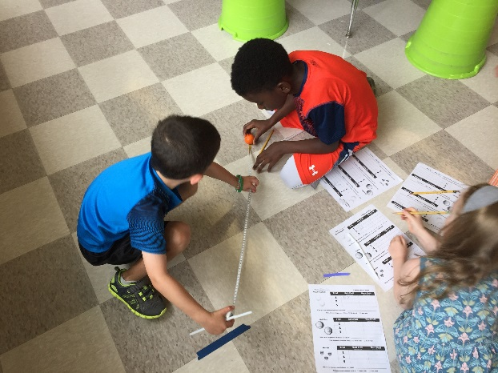
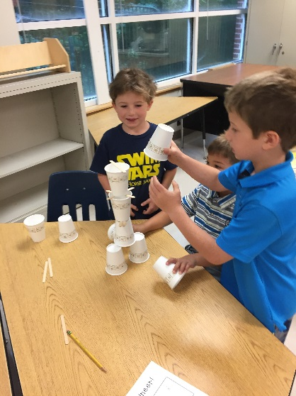
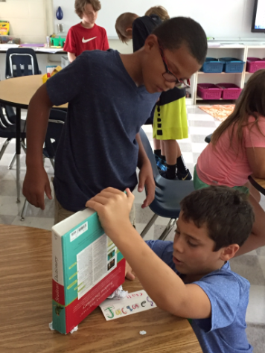
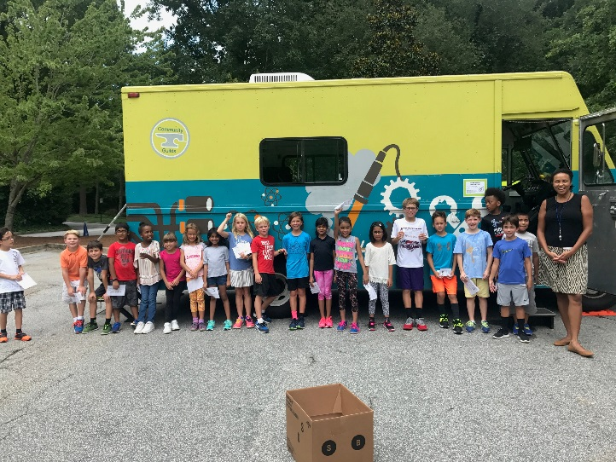
STEAM
Science Technology Engineering Arts Mathematics
STEAM learning is very hands-on and active. All students have STEAM Lab once a week with other school-wide opportunities and collaboration throughout the year.
​
Enhances our IB PYP program by emphasizing critical components of the IB program already occurring--
integration across the curriculum
project-based inquiry
local and global awareness
Preparing students for future careers & jobs
Interested in volunteering or do you work in a STEAM career?
Please email Laura Dostie at lmdostie@atlanta.k12.ga.us
Check us out at: www.wtjsteamlab.weebly.com

Slide 16
Contact Info
Email is the best way to reach me.
I am available for a conference within 24 hours.
dpreiss@atlanta.k12.ga.us
dmp1117@aol.com
704.309.7939

Slide 17
Dates to Remember
A sign-up Genius will be sent out in a few weeks for an October parent/teacher conference.
Georgia Milestones Assessment end of April.
5th graders are tested in ELA, Reading, Math, Science, and Social Studies.

Slide 18
Parent Volunteers
Kate Dolan and Sarah Lynch are our classroom room representatives
Parent Readers during Read-A-thon
Holiday parties
Read-a-thon begins week of November 6th.
Fifth Grade Trip to Jekyll Island February 7-9

